Slide 1




Satellite Design & Integration
Build Session 1
Structure, avionics and C&DH bring-up
Notes:
Day 3, Thursday 15 October. 11:00-12:00 and 13:00-13:45, 1 h 45 in total.

Slide 2



satellites!
Space mission
and
satellite
design course
Hands-on Slides

Slide 3
Build Session 1 — Structure, avionics and C&DH bring-up
Setting up the Arduino IDE
Notes:
Participants install the IDE before they arrive; this is the walk-through. Reference code: 1_HOW_TO_CREATE_A_FUNCTION_IN_ARDUINO_CODE, 2_HOW_TO_READ_ANALOG_SENSORS

Slide 4

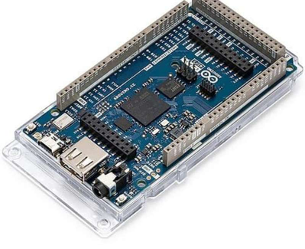

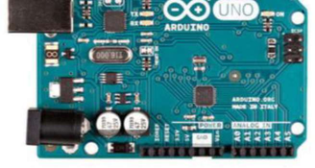


Why Arduino?
Arduino is an open-source platform. It includes:
It is a simple way to start learning electronics and programming.

Slide 5
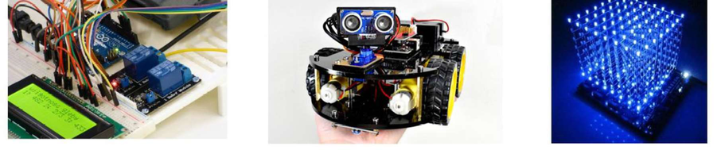
WhyWeUse Arduino
Arduino is:
It allows you to:

Slide 6
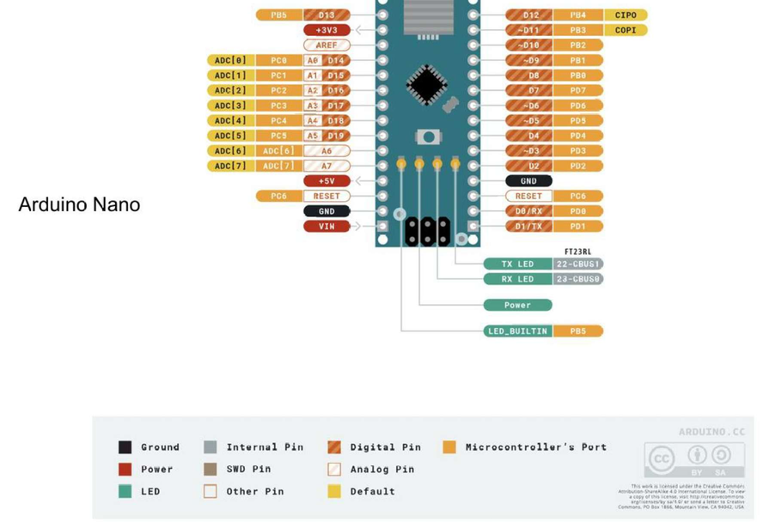
What Is Inside an Arduino?
An Arduino board includes:
Microcontroller
peripherals
Input / Output pins
actuators Power supply
It is a small embedded system.

Slide 7
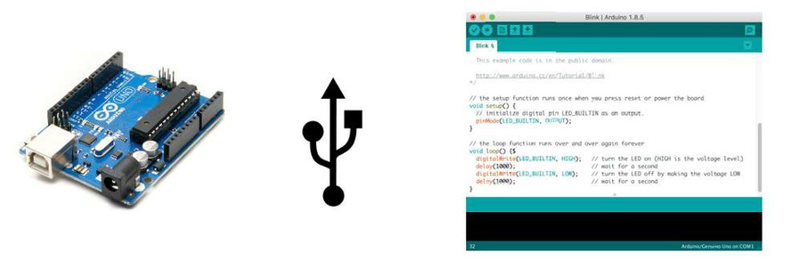
Programming Arduino
Arduino is programmed via:
You write code on your computer and upload it in seconds.

Slide 8
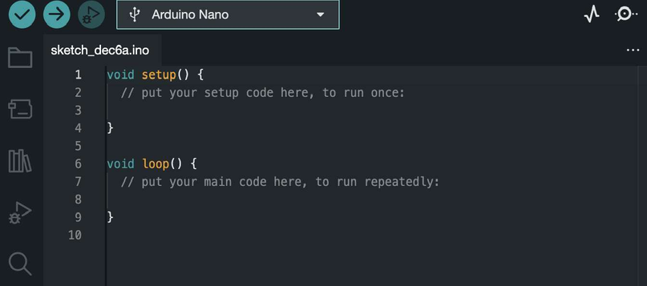
Arduino Programming Set Up
website https://github.com/arduino/arduino-
ide/releases/tag/2.3.4
Find the 2.3.4 version of Arduino IDE for either Mac or Windows.

Slide 9

Arduino Programming Set Up

Slide 10
Arduino Programming Set Up
Install the first library you see appearing.

Slide 11
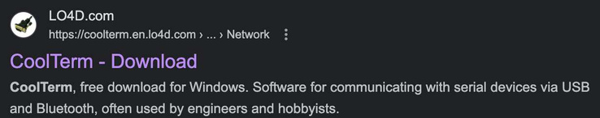
Arduino Programming Set Up
that got installed with the IDE.
Copy and paste there the library folders we are going to use in programming the satellite.
recognize Arduino Nano.

Slide 12
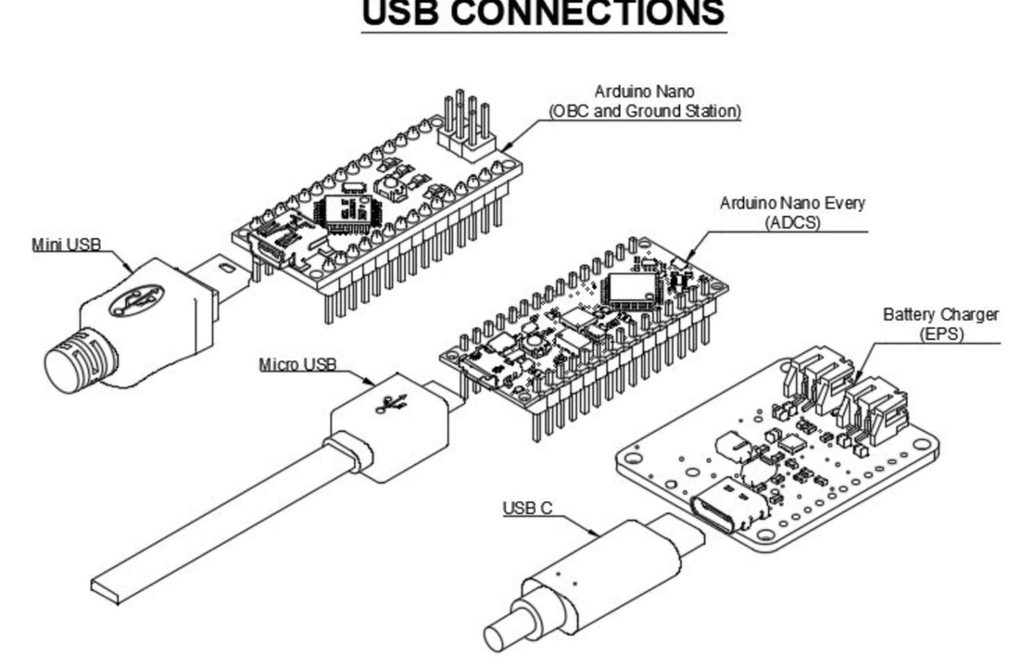
Arduino Nano vs Arduino Nano Every

Slide 13
Introduction to Arduino IDE
Basic interface:
1.
Create a new sketch, save, open examples.
2."Verify" checks the syntax and compiles the code to identify
errors without uploading it to the board.
3.
Arduino board, making it ready to execute the program on the hardware.
4.Board and COM Port selection
5.
Board selection (either Arduino Nano or Nano Every)
6.COM Port selection
7.
8.Open/Close Serial Monitor 9.Clear Serial Monitor

Slide 14
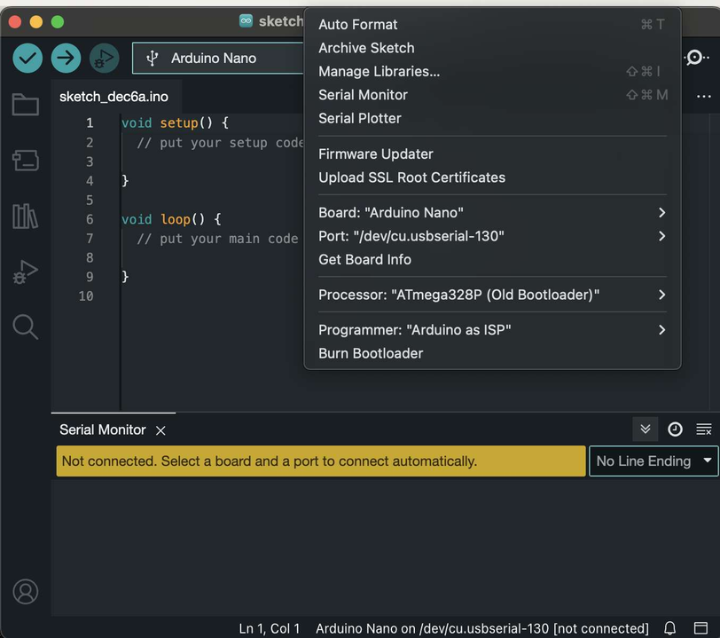
1
2
3
8
4
5 6
7
9

Slide 15
Build Session 1 — Structure, avionics and C&DH bring-up
The kit, the tools and the boards
Notes:
Open the boxes, inspect the EPS with the multimeter, assemble the ground station board. No code.

Slide 16
Satellite Kit Overview
Open your satellite boxes!
everything we are going to need is there:
Satellite subsystems (electronic boards).

Slide 17
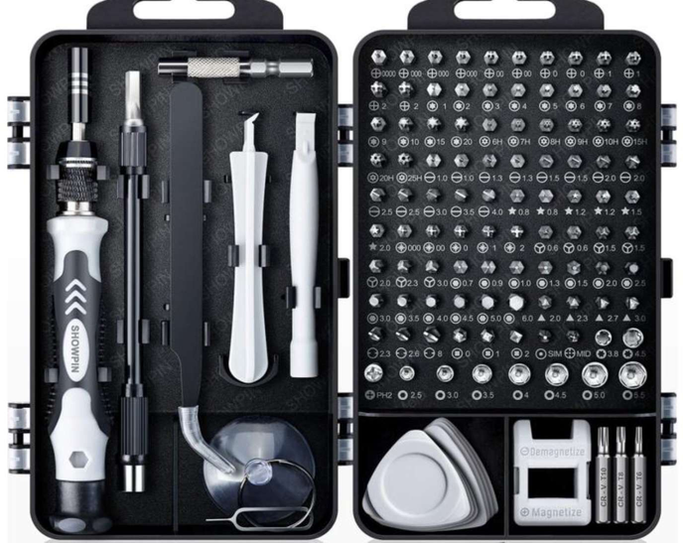
Screwdriver Set
The screwdriver set includes a variety of bits to accommodate the diverse types of screws used in different devices and applications.
Various screws exist due to the need for specialized fastening solutions in manufacturing and design. Using the right bit for the corresponding screw head is crucial to prevent damage to screws or the bits themselves.

Slide 18
Screwdriver Set
We have for instance:
Hex screws, common in furniture and electronics.
Phillips-head screws offering efficient torque transmission in many applications.
Torx screws that provide enhanced security and durability.
Now refer to the cubeSat assembly manual inside the Starter kit

Slide 19
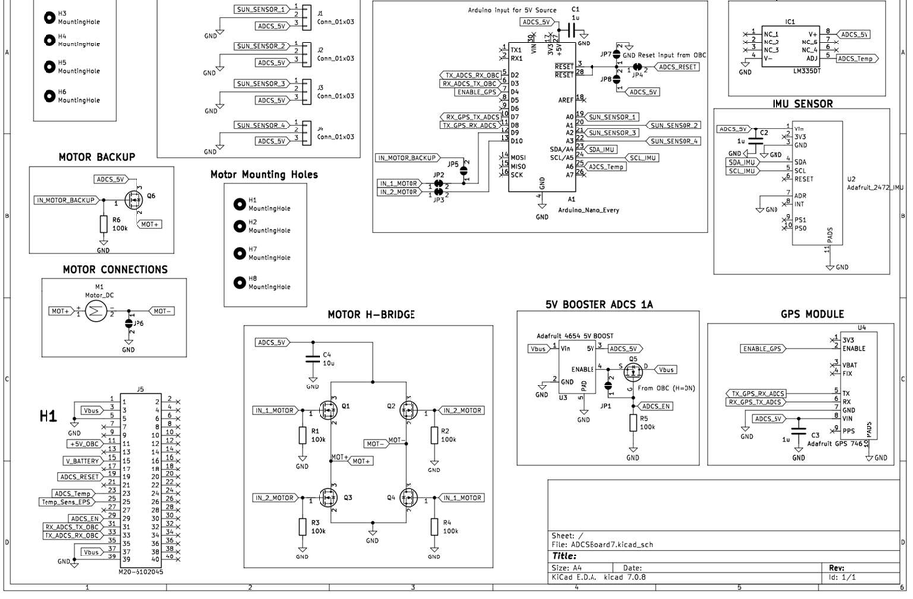
Satellite Boards Schematics

Slide 20
Satellite Set Up
Follow the guide:
Read carefully and understand each step before proceeding. Strictly adhere to the guide's sequence; do not skip or advance independently.
Do not power subsystems until instructed:
Avoid connecting or powering subsystems prematurely to prevent conflicts. Keep the RBF plugged in.
Use the screwdriver set correctly:
Use the right size of the screwdriver inserts for each specific screw.
Avoid over-tightening screws; tighten securely without excessive force to prevent damage.

Slide 21

EPS Testing!
By looking at the EPS schematics, use the continuity function of the multimeter to check ground connections around the board.
Find and show me at least 5 ground (GND) connections using the multimeter.
Be careful not to short circuit anything with the tips of multimeter probes!

Slide 22
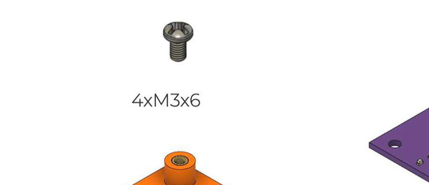
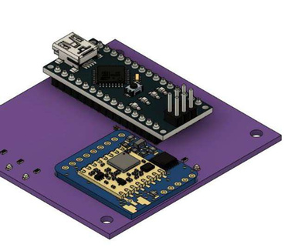
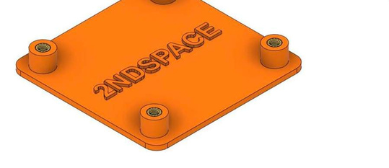
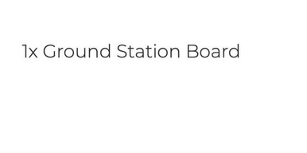
Building the Ground Station (GS)

Slide 23
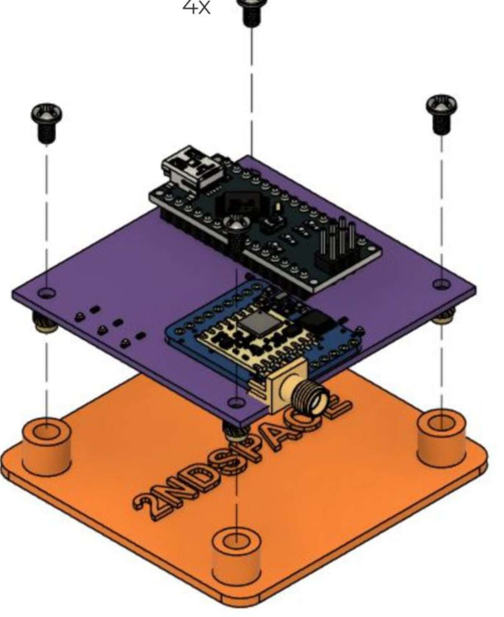
Building the Ground Station (GS)

Slide 24
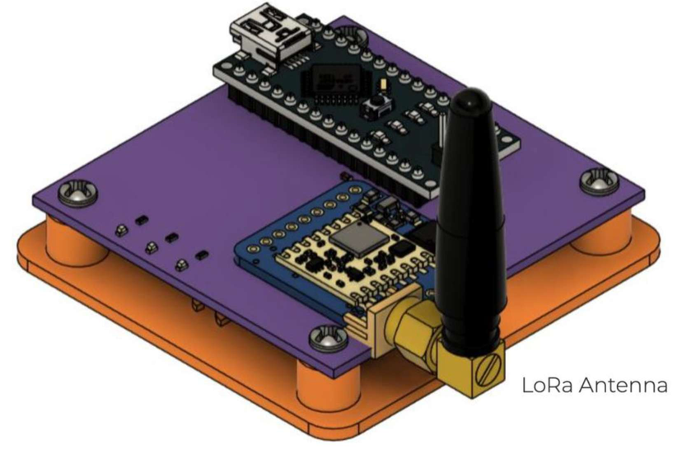
Building the Ground Station (GS)

Slide 25
Building the Ground Station (GS)

Slide 26

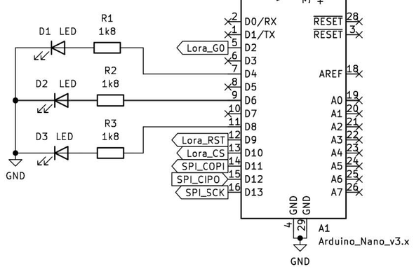
Building the Ground Station (GS)

Slide 27


Building the Ground Station (GS)
In the GS we have SMD LEDs.
SMD components are smaller, mounted directly on the PCB surface, and suitable for automated production.
PTH components are larger, have leads through holes, and are often manually soldered.

Slide 28
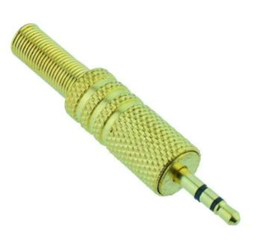

Satellite Set-up -EPS
First of all: find the RBF (Remove Before Flight) jack and plug it in the EPS
=

Slide 29
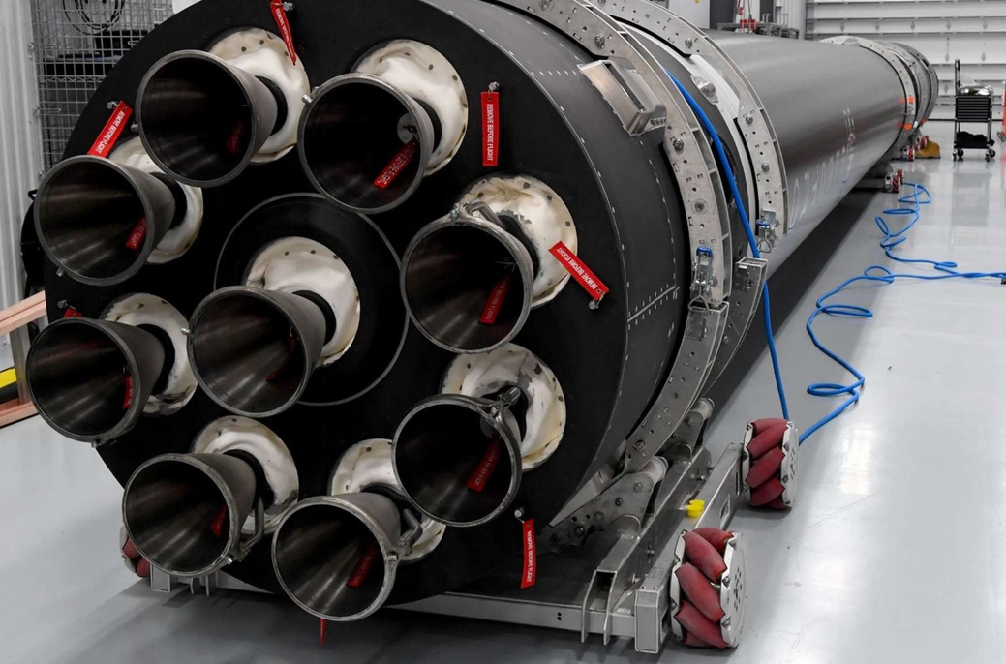
Satellite Set-up -EPS

Slide 30
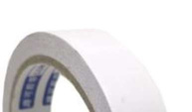
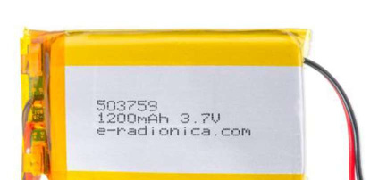
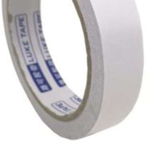

Satellite Set-up -EPS
double-sided tape and then plug the battery into its connector.

Slide 31
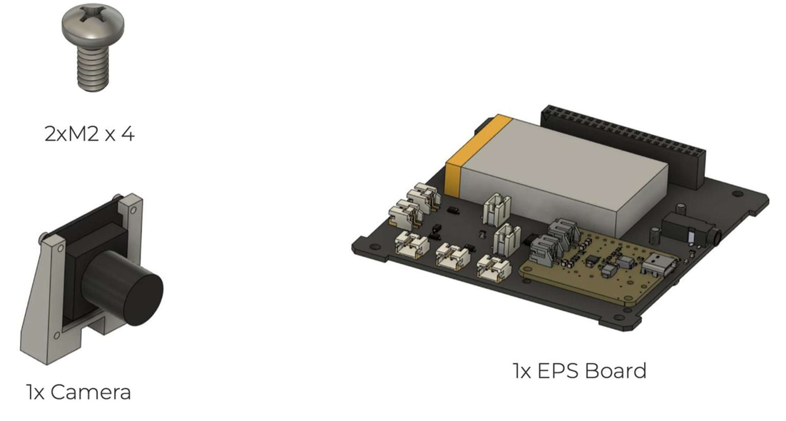
Satellite Set-up -EPS

Slide 32

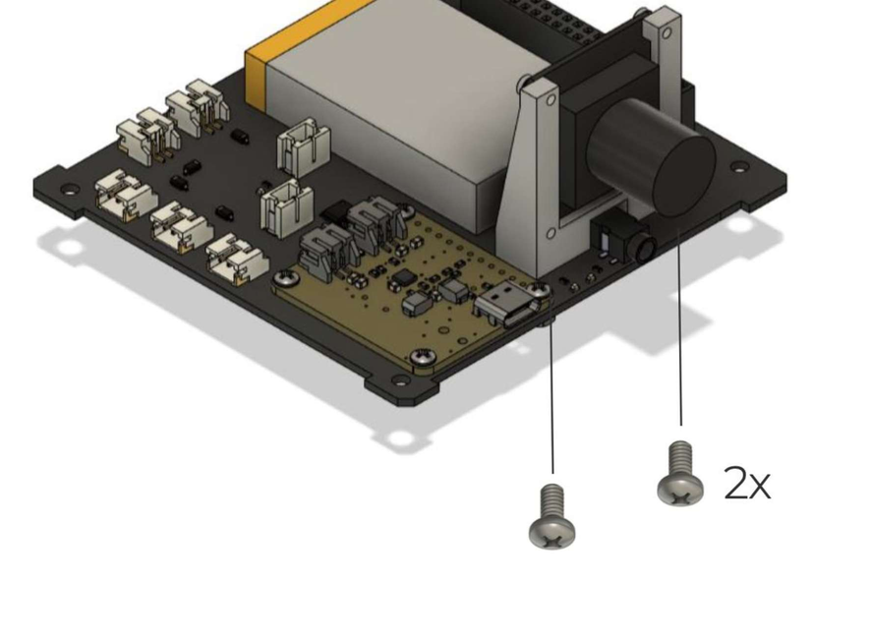
Satellite Set-up -EPS

Slide 33
Satellite Set-up -ADCS

Slide 34
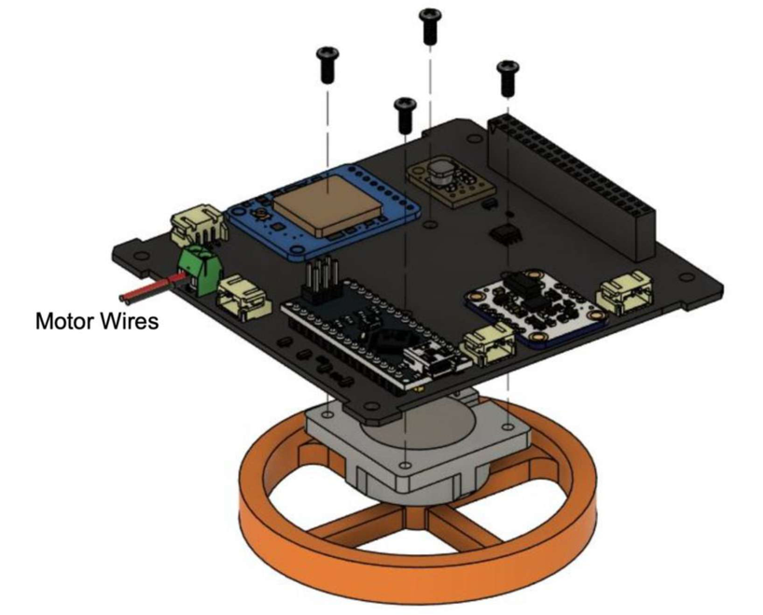
Satellite Set-up
Be careful with the motor wires, unroll them from the motor case and plug them into the connector.

Slide 35
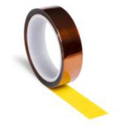

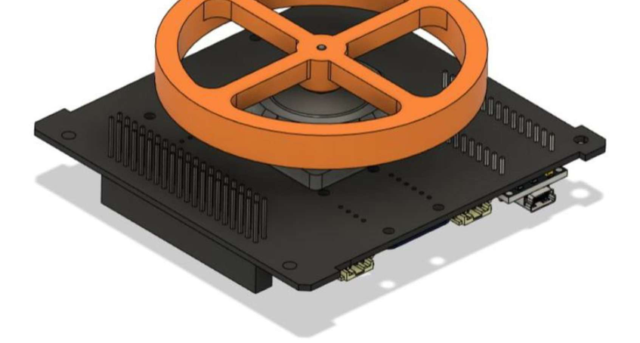
Satellite Set-up -ADCS
-104 connector pins with kapton tape
Use the same tape to secure motor wires to the board so
or get close to exposed pins.

Slide 36
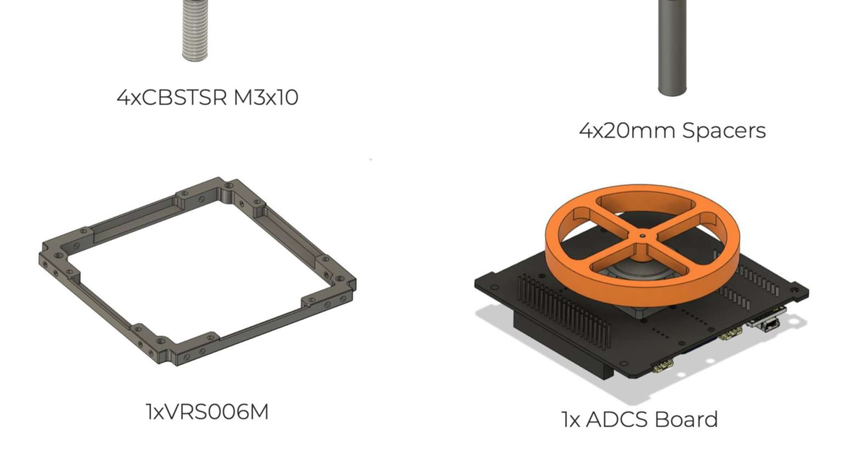
Satellite Set-up -Bottom side

Slide 37
Satellite Set-up -Bottom side
Look at the orientation of the
bottom frame!

Slide 38
Satellite Set-up -OBC and ADCS Stack

Slide 39
Satellite Set-up -OBC and ADCS Stack

Slide 40
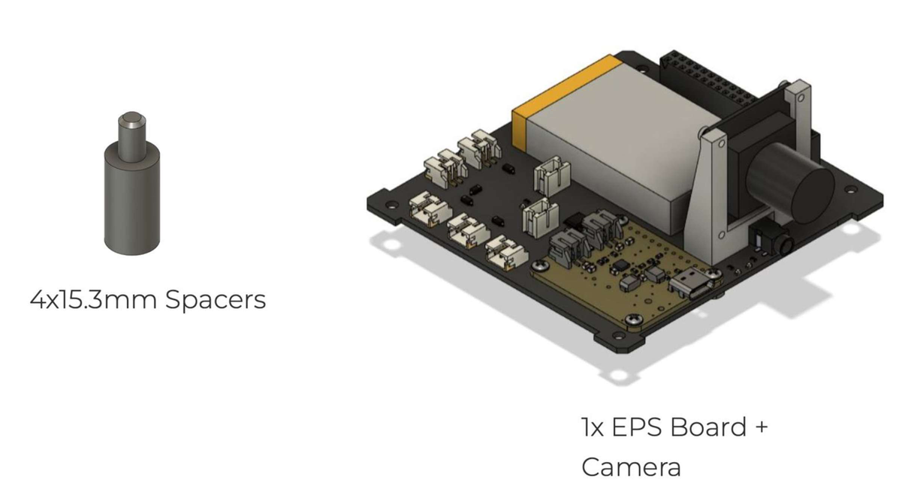
Satellite Set-up -Preparing the Full Stack

Slide 41
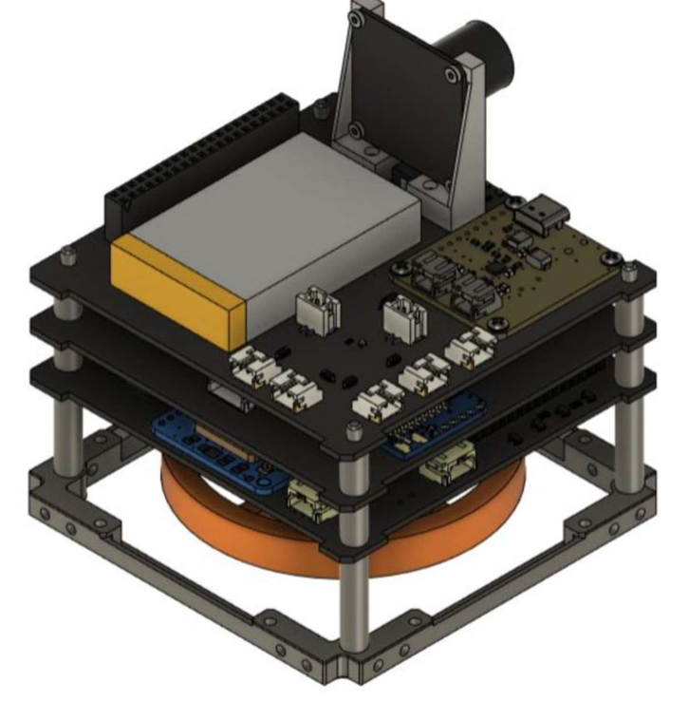
Satellite Set-up -Full Stack
Plug the camera connector to the
OBC BEFORE placing the EPS on
top of it!

Slide 42
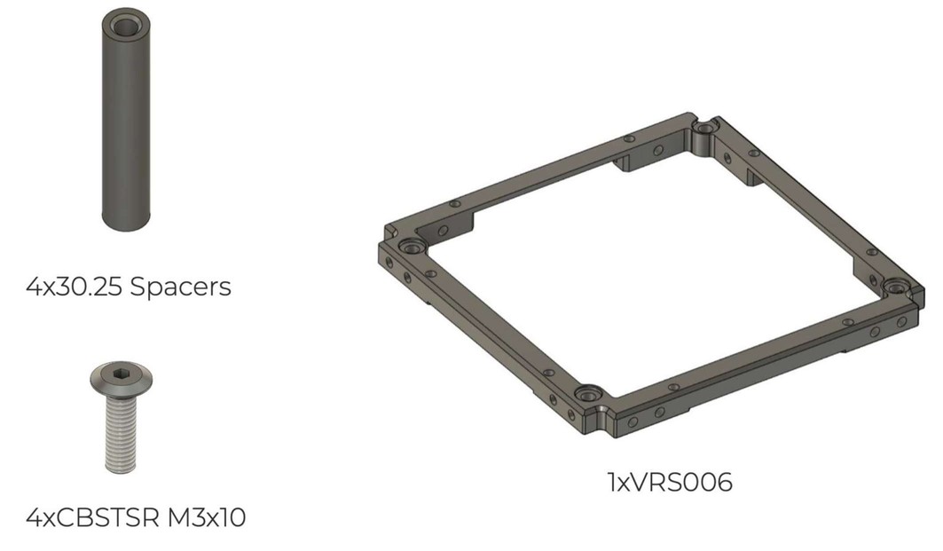
Satellite Set-up -Top Frame
Build the top frame of the 1U in a similar way as for the bottom frame

Slide 43
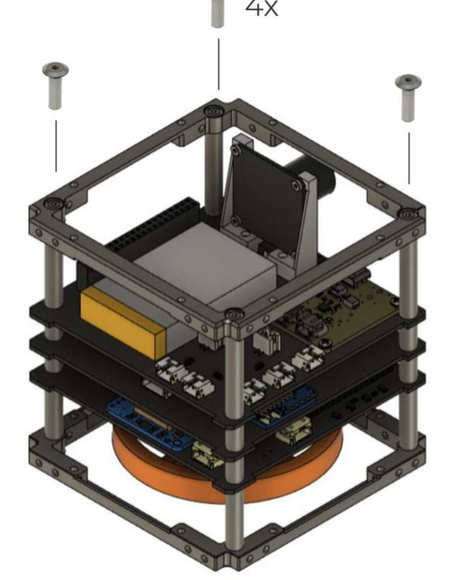
Satellite Set-up -Top Frame

Slide 44
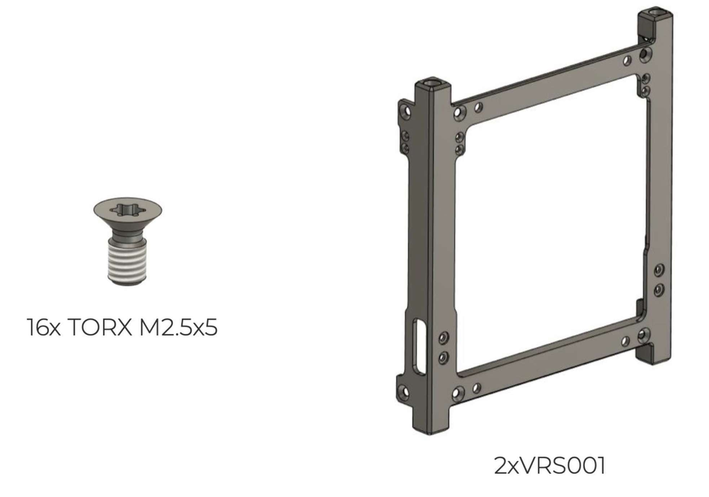
Satellite Set-up -Side Structures

Slide 45
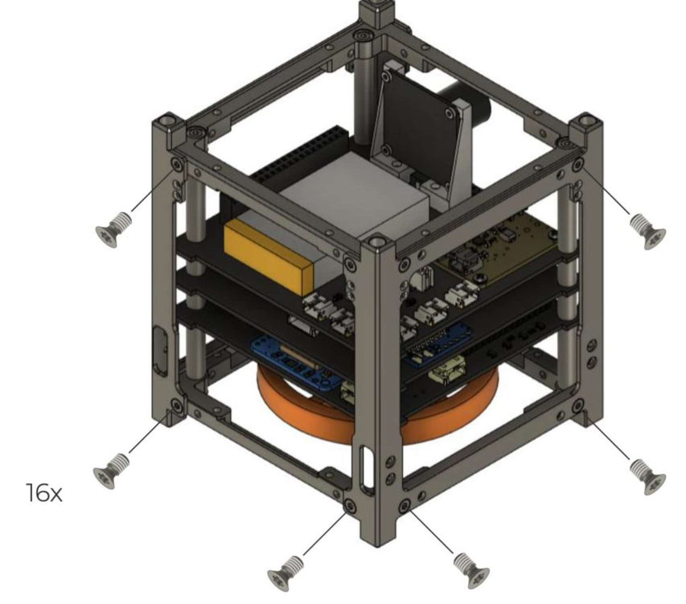
Satellite Set-up -Side Structures
Pay attention to the mounting
direction of the side structures

Slide 46
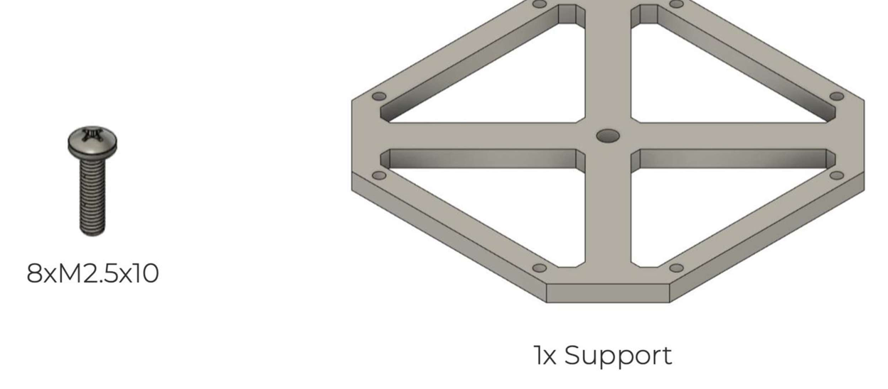
Satellite Set-up -Bottom Guard

Slide 47
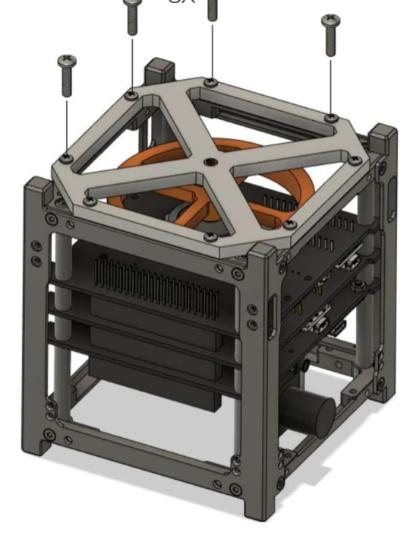
Satellite Set-up -Bottom Guard

Slide 48
Satellite Set-up -Boards Check
Before continuing with the satellite mechanical set- sure our boards can be programmed!
Remember:
Arduino Nano
-OBC & Ground Station
Arduino NanoEvery
-ADCS

Slide 49

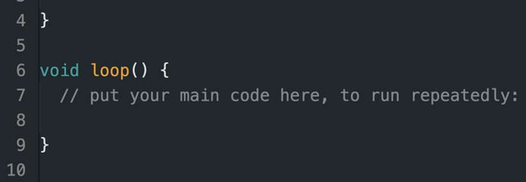
Satellite Set-up -Boards Check
Hardware side:
Connect the USB C to the EPS and plug it in your PC. Now remove the RBF.
Software side:
Open a new sketch in Arduino IDE -do not write any code in it

Slide 50

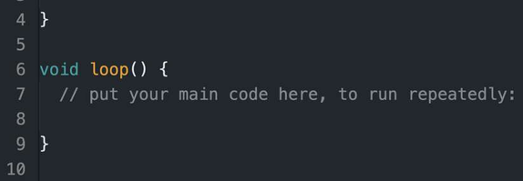
Satellite Set-up -Boards Check
Software side:
Open a new sketch in Arduino IDE -do not write any code in it Connect and upload the empty code on the OBC first.
Then, disconnect the OBC cable.
Connect and upload the empty code on the ADCS.

Slide 51
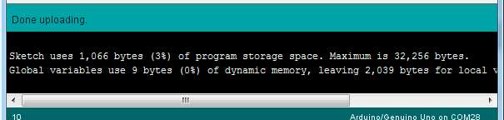
Satellite Set-up -Boards Check
Hardware side:
Plug the RBF back in.
Remove the remaining Arduino cable. Remove the USB C cable from the EPS.
Now we know that both OBC and the ADCS can be programmed!

Slide 52
During this workshop, we will cover all the relevant aspects of Arduino programming, using the satellite as an example of a complete platform with inputs, outputs, both digital and analog, sensors, communication modules, and more.
Utilize all available online resources to help you figure out how to complete the exercises.
Please refrain from using ChatGPTor other AI systems, as they may provide solutions that can be misinterpreted, potentially leading to errors or a lack of understanding of how microcontroller programming works.

Slide 53

IMPORTANT INFORMATION!
If you mistakenly tell an INPUT pin to act like an OUTPUT in your Arduino code and it tries to send or receive current, you could end up damaging your Arduino.
Coding Mistake: If you accidentally make an INPUT pin behave like
an OUTPUT
in your code, it means you're giving it the wrong
instructions. INPUT pins are meant to sense signals, while OUTPUT pins are used to send signals or power devices like LEDs. If you mix them up in your code and tell an INPUT pin to send current, it can lead to too much current flowing through the pin, possibly harming your Arduino.
Always double check what code are you uploading on the Arduino!

Slide 54

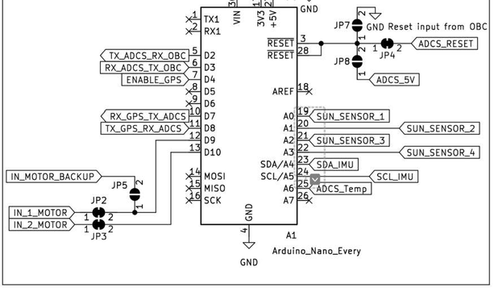

How to Read Arduino Pinouts
When writing the code, you need to read the pinout from here (internal side of the box) EXAMPLE

Slide 55
Open a new sketch for the OBC
Open a
new sketch
and save it as OBC_Exercises.

Slide 56
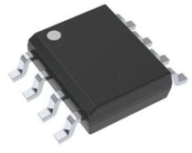
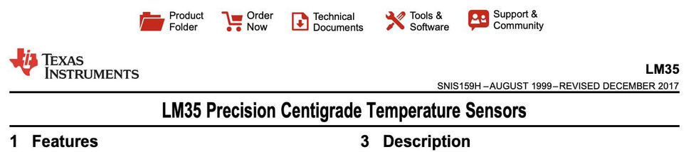
Reading the OBC temperature sensor
The OBC has a temperature sensor, LM35, which is an analog sensorconnected to pin A1.
Look at the online datasheet of the LM35 to understand how it reads temperature and find a way to display it in the serial monitor every 2 seconds.
The output should look like: TEMPOBC = 26.2 deg
Find a way to request the temperature using the string 'TEMPOBC' and display it on the serial monitor when requested.

Slide 57
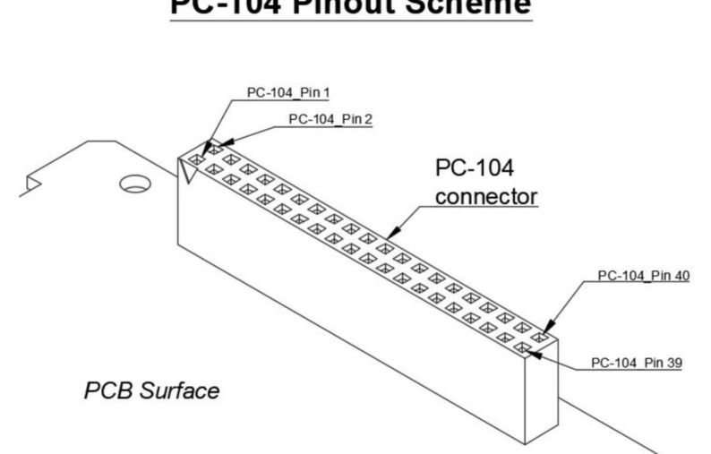
Reading sensors across PC104
We can read sensors from other boards around the satellite using the industry- standard PC104 connector.

Slide 58
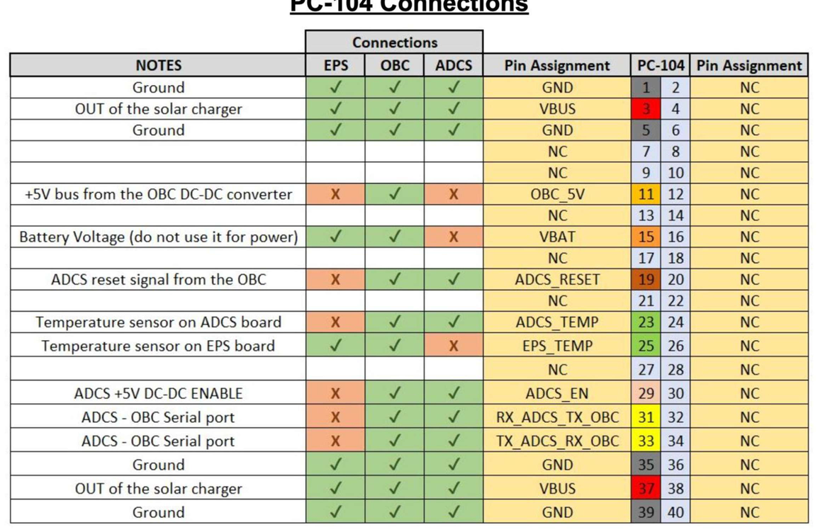
OBC Exercises

